Slide 1
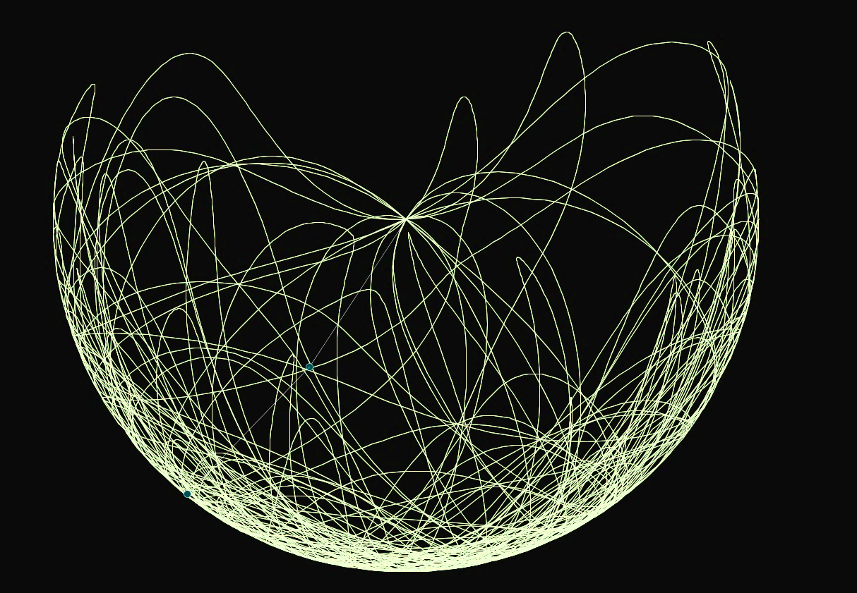

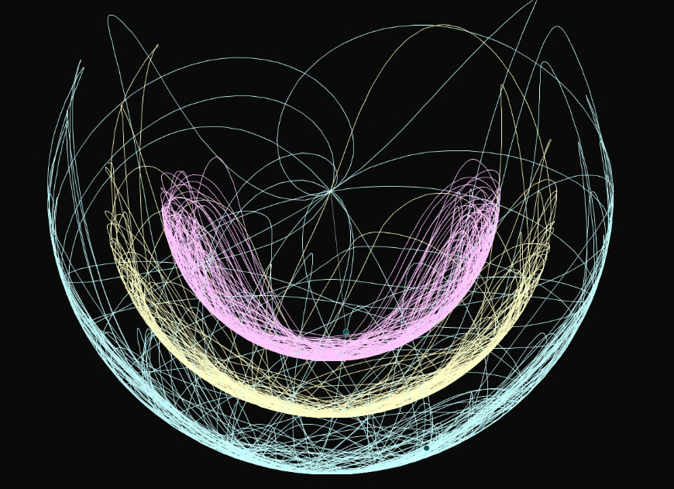
Double Pendulum
Physics Project

Slide 2
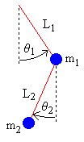
Kinematics of the Double Pendulum
Begin by using simple trigonometry to write expressions for the positions x₁, y₁, x₂, y₂ in terms of the angles θ₁, θ₂ .
x₁ = L₁ sin θ₁
y₁ = −L₁ cos θ₁
x₂ = x₁ + L₂ sin θ₂
y₂ = y₁ − L₂ cos θ₂
The velocity is the derivative with respect to time of the position.
x₁' = θ₁' L₁ cos θ₁
y₁' = θ₁' L₁ sin θ₁
x₂' = x₁' + θ₂' L₂ cos θ₂
y₂' = y₁' + θ₂' L₂ sin θ₂
The acceleration is the second derivative.
x₁'' = −θ₁'² L₁ sin θ₁ + θ₁'' L₁ cos θ₁ ------ (1)
y₁'' = θ₁'² L₁ cos θ₁ + θ₁'' L₁ sin θ₁ ------ (2)
x₂'' = x₁'' − θ₂'² L₂ sin θ₂ + θ₂'' L₂ cos θ₂ ------ (3)
y₂'' = y₁'' + θ₂'² L₂ cos θ₂ + θ₂'' L₂ sin θ₂ ------ (4)

Slide 3


Forces in the Double Pendulum
m₁ x₁'' = −T₁ sin θ₁ + T₂ sin θ₂ ------ (5)
m₁ y₁'' = T₁ cos θ₁ − T₂ cos θ₂ − m₁ g ------ (6)
m₂ x₂'' = −T₂ sin θ₂ ------ (7)
m₂ y₂'' = T₂ cos θ₂ − m₂ g ------ (8)
m₁ x₁‘’ = −T₁ sin θ₁ − m₂ x₂‘’ ------ (9)
m₁ y₁‘’ = T₁ cos θ₁ − m₂ y₂‘’ − m₂ g − m₁ g ------ (10)
Upper mass
Lower mass

Slide 4
Direct Method for Finding Equations of Motion
T₁ sin θ₁ cos θ₁ = −cos θ₁ (m₁ x₁'' + m₂ x₂'') ------ (11)
T₁ sin θ₁ cos θ₁ = sin θ₁ (m₁ y₁'' + m₂ y₂'' + m₂ g + m₁ g) ------ (12)
sin θ₁ (m₁ y₁'' + m₂ y₂'' + m₂ g + m₁ g) = −cos θ₁ (m₁ x₁'' + m₂ x₂'') ------ (13)
T₂ sin θ₂ cos θ₂ = −cos θ₂ (m₂ x₂'') ------ (14)
T₂ sin θ₂ cos θ₂ = sin θ₂ (m₂ y₂'' + m₂ g) ------ (15)
sin θ₂ (m₂ y₂'' + m₂ g) = −cos θ₂ (m₂ x₂'') ------ (16)
θ₁'' = | −g (2 m₁ + m₂) sin θ₁ − m₂ g sin(θ₁ − 2 θ₂) − 2 sin(θ₁ − θ₂) m₂ (θ₂'² L₂ + θ₁'² L₁ cos(θ₁ − θ₂))
 | L₁ (2 m₁ + m₂ − m₂ cos(2 θ₁ − 2 θ₂))
θ₂'' = | 2 sin(θ₁ − θ₂) (θ₁'² L₁ (m₁ + m₂) + g(m₁ + m₂) cos θ₁ + θ₂'² L₂ m₂ cos(θ₁ − θ₂))
 | L₂ (2 m₁ + m₂ − m₂ cos(2 θ₁ − 2 θ₂))

